Slide 1
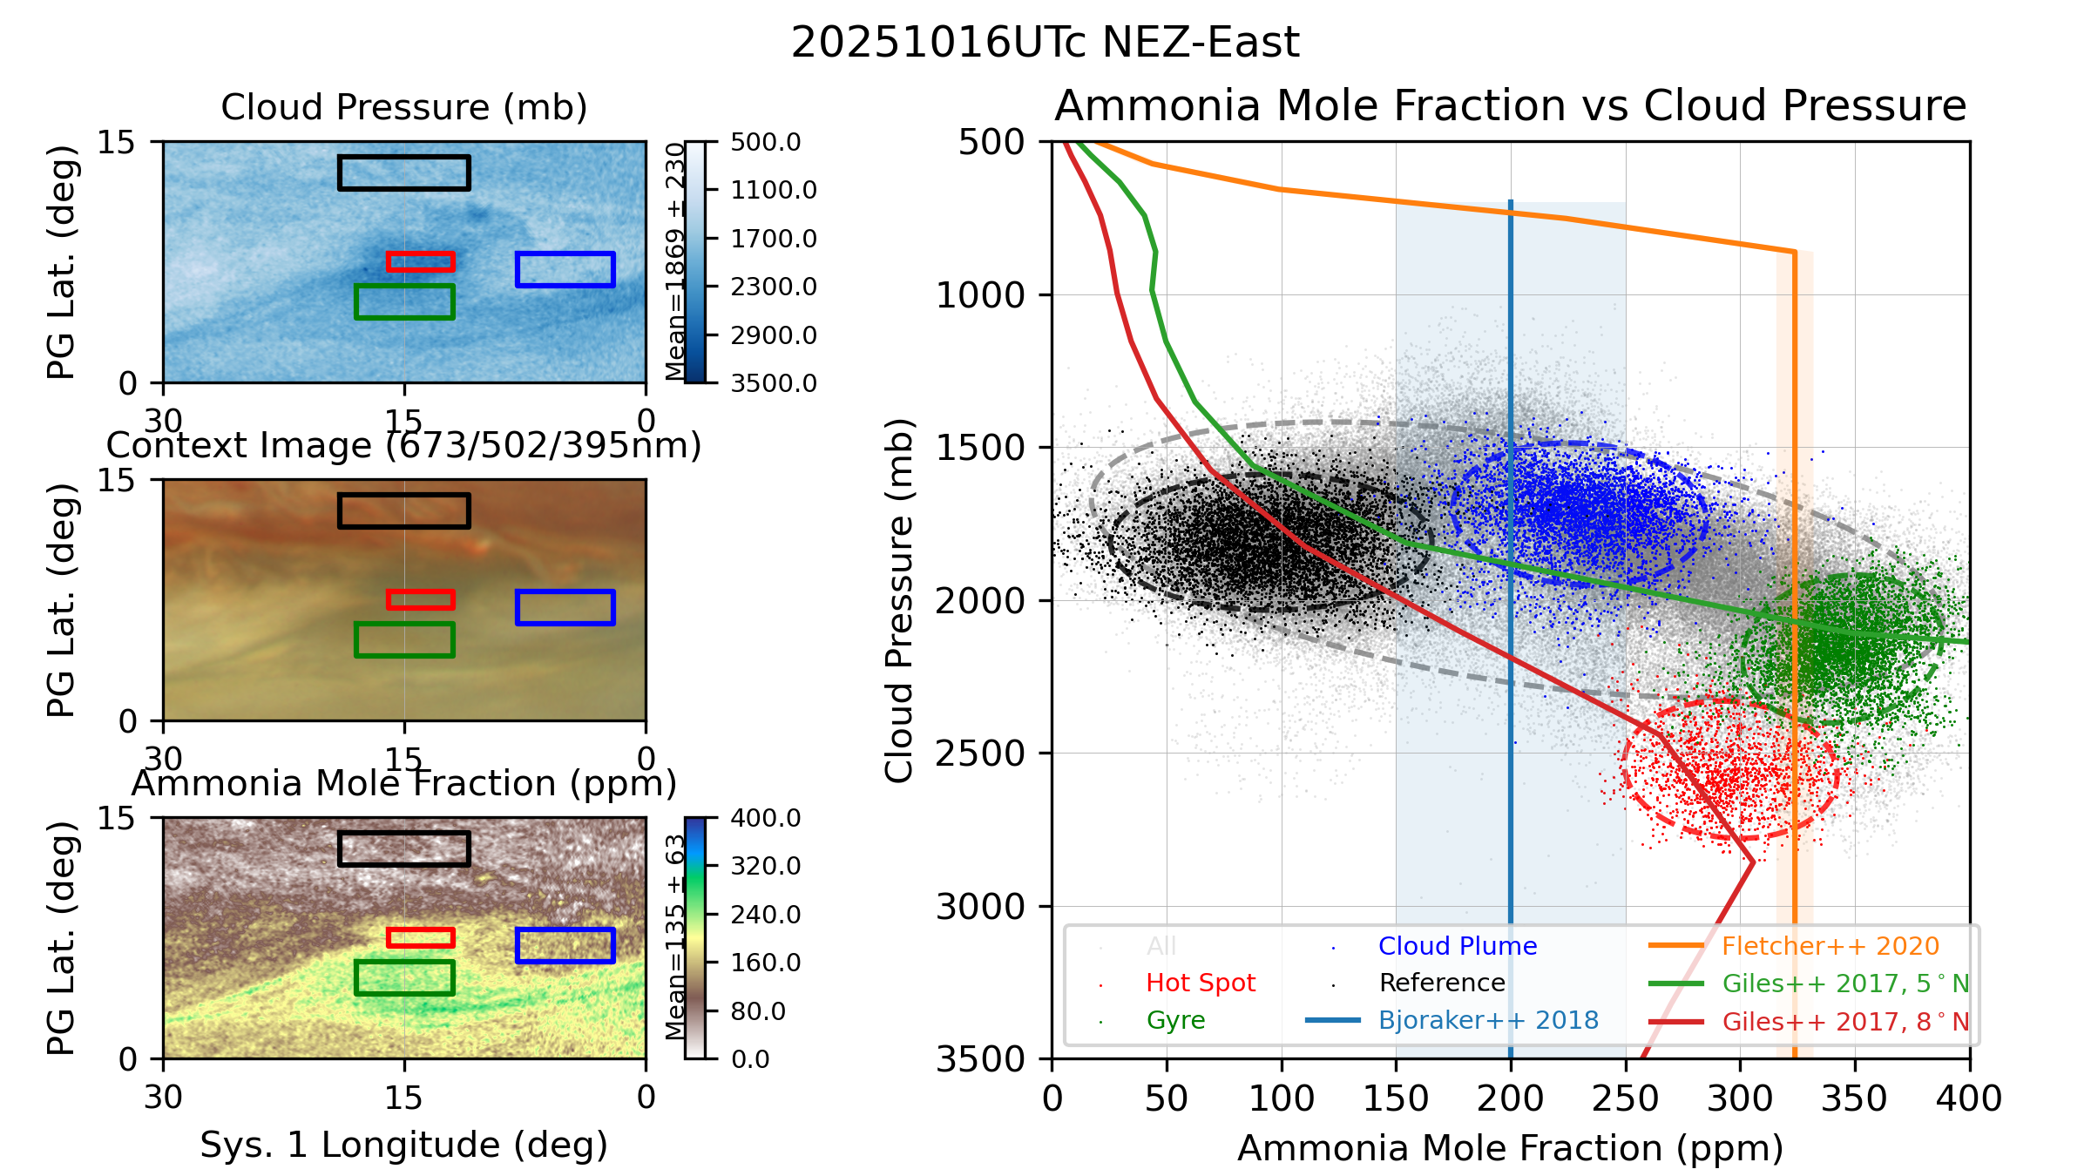
f_{NH3} vs P_{Cld}
CI vs AOI
Resid vs Correl
DATA SET / STUDY AREA
SCATTER PLOT OVERLAYS
20251016UTc NEZ-East
Comparison Profiles
Giles++ 2017
Fletcher++ 2020
Bjoraker++ 2018
Juno MWR
MAP OVERLAYS
Min. Lat.
Comparison Profiles
Max. Lat.
Cluster Data
ROIs
ROI Ellipses
Contours
GMM Ellipses
Extrema
No. of Clusters
Segmentation
GMM
No. of Clusters
DATA AREA
obs_id | dateobs | roilabel | nsamples | mean1 | stdv1 | mean2 | stdv2 | slope | intercept | r_value | p_value | std_err | cov_matrix
20251016UTc | 2025-10-16 3:01:29 | All | 180000 | 1869.4 | 230.0 | 202.8 | 94.7 | 1.065 | 1653.3 | 0.439 | 0.0000000 | 0.0051 | [[52917.39528505 9556.47331587] [ 9556.47331587 8969.69384602]]
20251016UTc | 2025-10-16 3:01:29 | Hot Spot | 1600 | 2555.9 | 114.5 | 295.9 | 23.7 | 0.435 | 2427.0 | 0.090 | 0.0003097 | 0.1204 | [[13115.11650713 244.35212806] [ 244.35212806 561.25832953]]
20251016UTc | 2025-10-16 3:01:29 | Gyre | 4800 | 2161.1 | 123.5 | 344.4 | 22.2 | -0.764 | 2424.4 | -0.137 | 0.0000000 | 0.0797 | [[15255.8860011 -375.5043863] [ -375.5043863 491.2045526]]
20251016UTc | 2025-10-16 3:01:29 | Cloud Plume | 4800 | 1719.6 | 118.7 | 230.0 | 28.2 | 0.352 | 1638.6 | 0.084 | 0.0000000 | 0.0606 | [[14094.61015647 279.68908074] [ 279.68908074 794.47609748]]
20251016UTc | 2025-10-16 3:01:29 | Reference | 6400 | 1811.6 | 113.5 | 95.6 | 35.7 | -0.018 | 1813.3 | -0.006 | 0.6563441 | 0.0397 | [[12877.6873732 -22.5693302 ] [ -22.5693302 1278.09241273]]

